Slide 1

Prof. Jonathan Chase
Advanced Community Ecology Course at Peking University
Lecture 3: Biodiversity Patterns

Slide 2
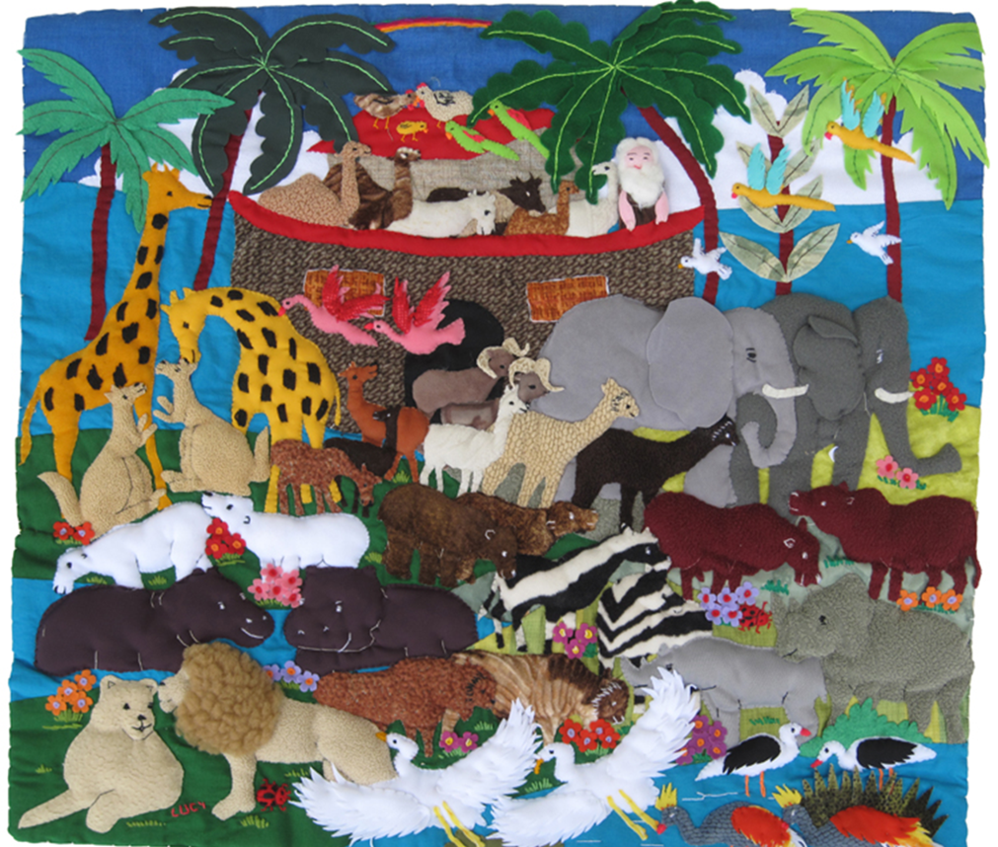


Slide 3
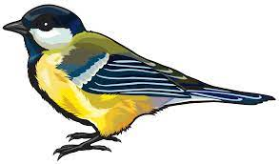

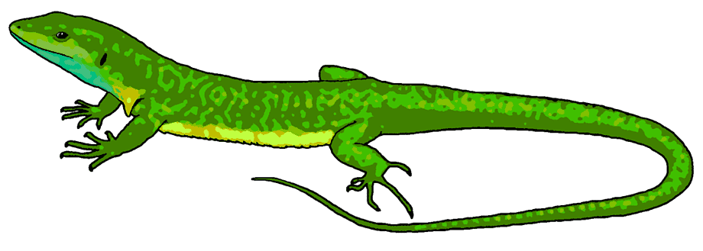








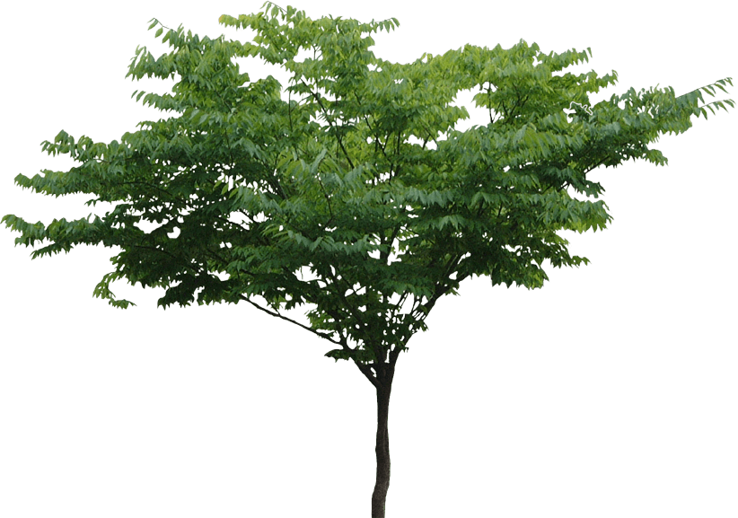
Organism/individual
Population/ Metapopulation
Community/Metacommunity
Coexistence/Assembly
Richness/diversity/Evenness
Scale and Beta-Diversity
Change through time (stability)
Food Webs and trophic structure (also mutualisms)
Biodiversity and ecosystem functioning (BEF)
Ecosystem fluxes and cycles
Time

Slide 4

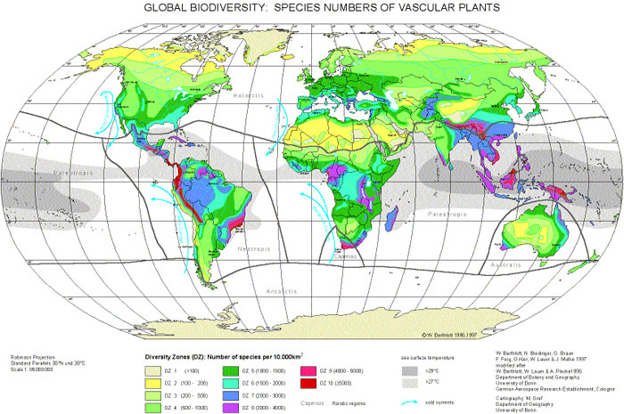
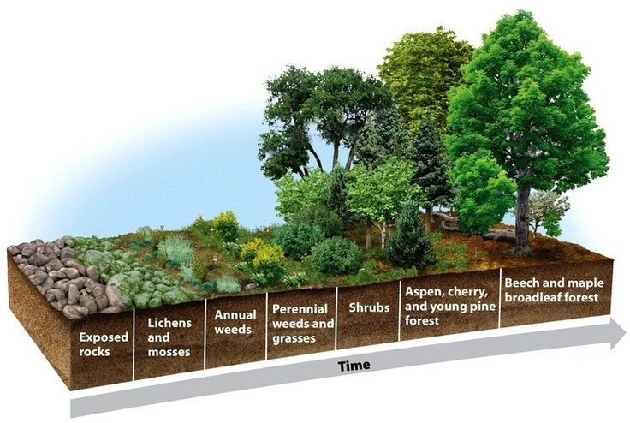
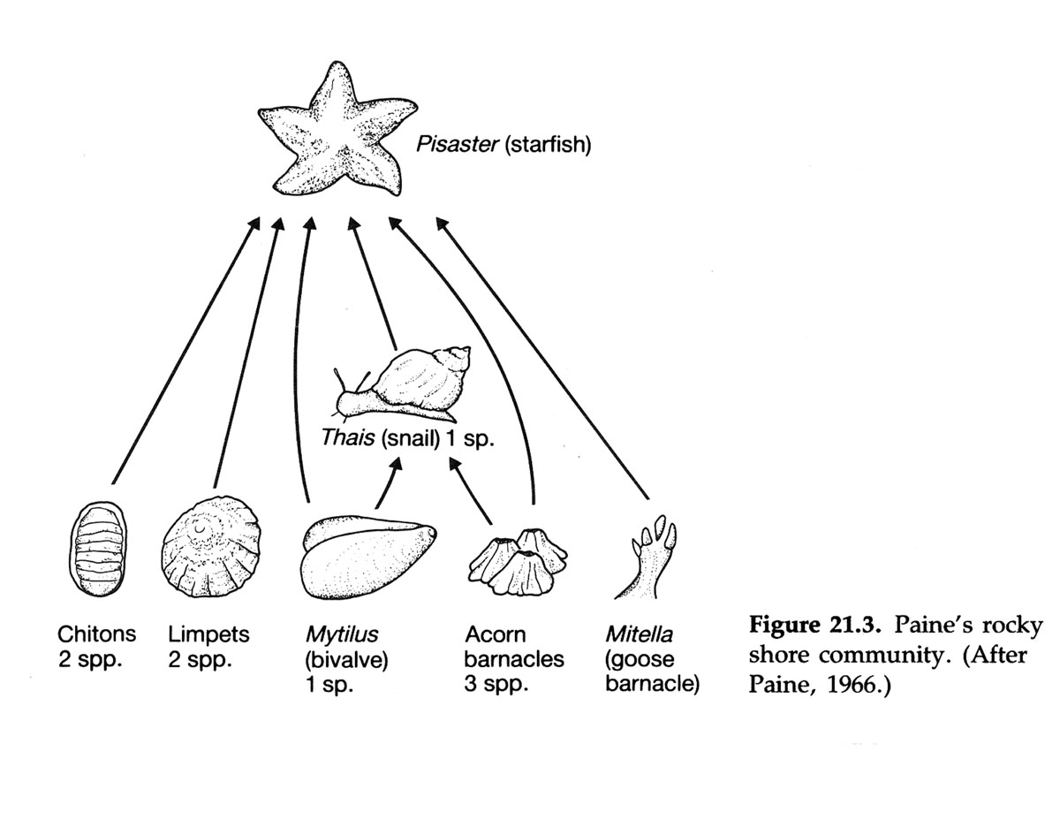
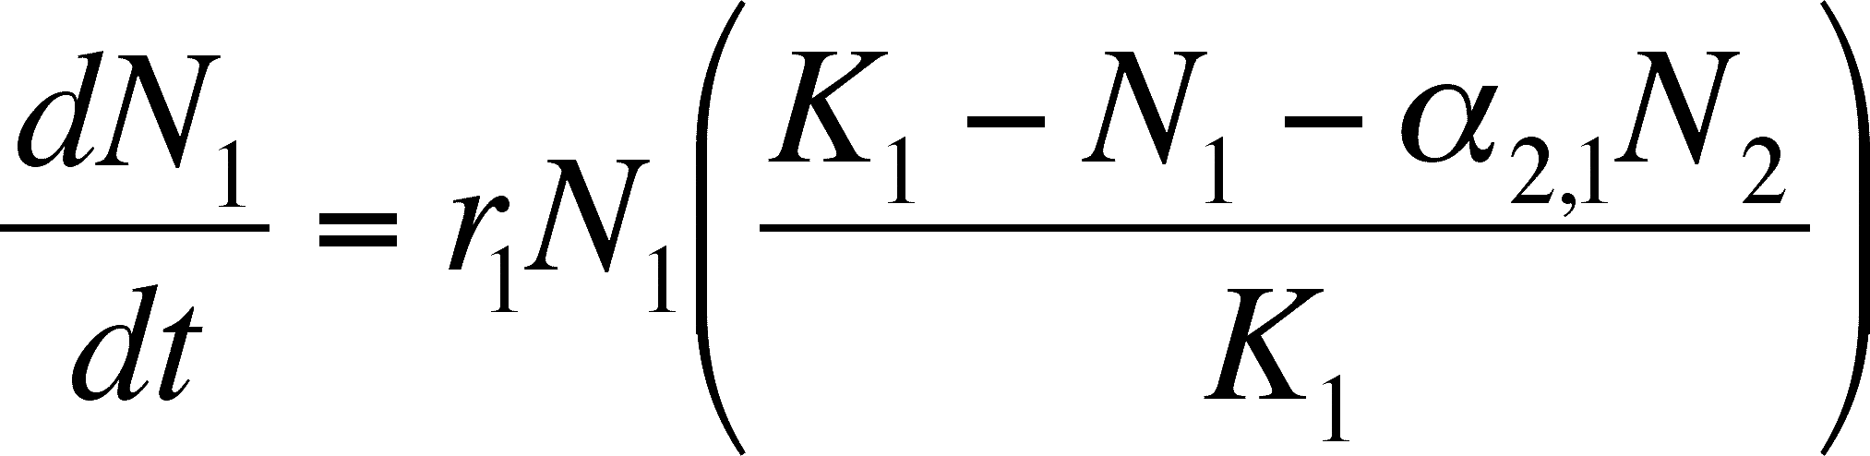
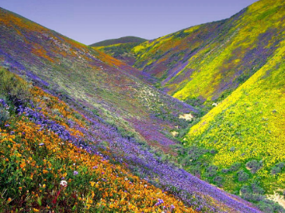

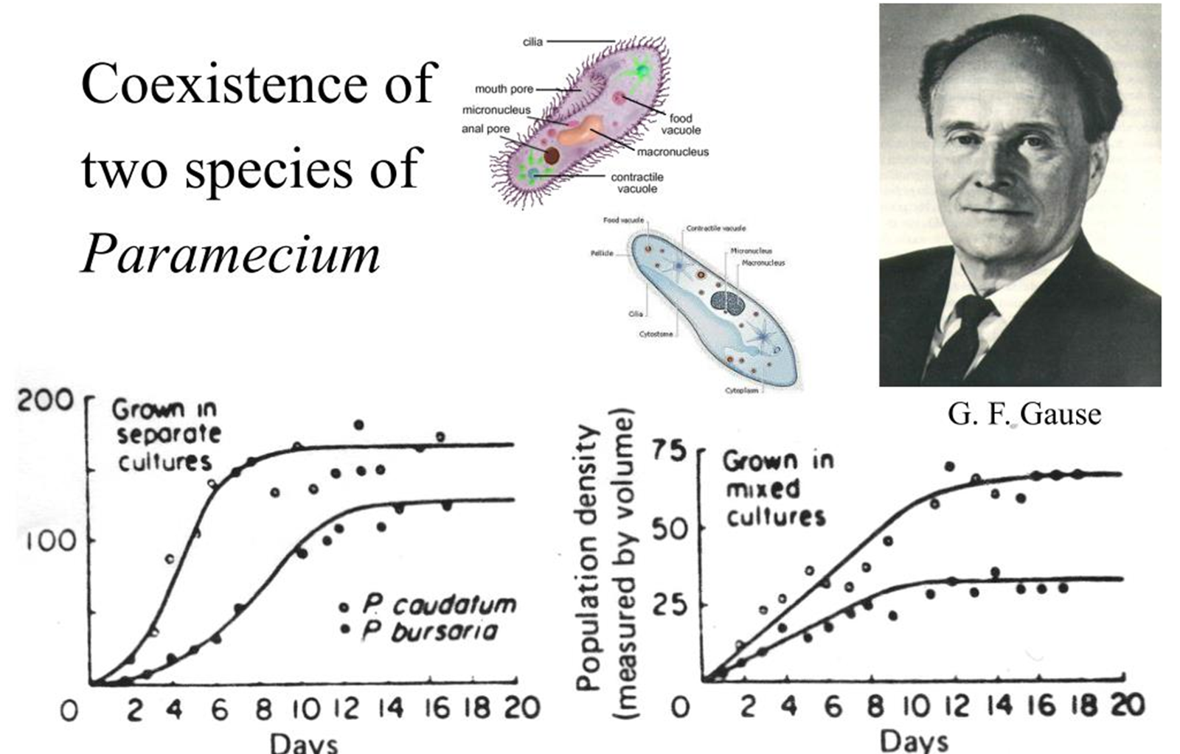
Process→Pattern
Pattern→Process

Slide 5
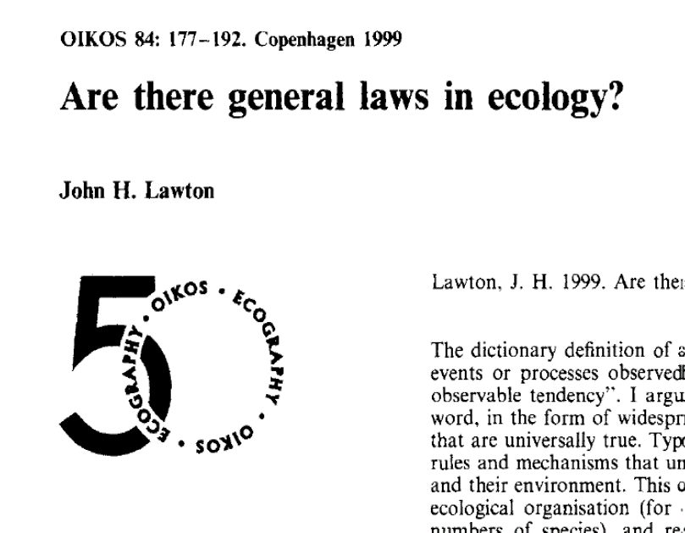

“To discover general patterns, laws and rules in nature, ecology may need to pay less attention to the ‘middle ground’ of community ecology, relying less on reductionism and experimental manipulation, but increasing research efforts in macroecology”

Slide 6





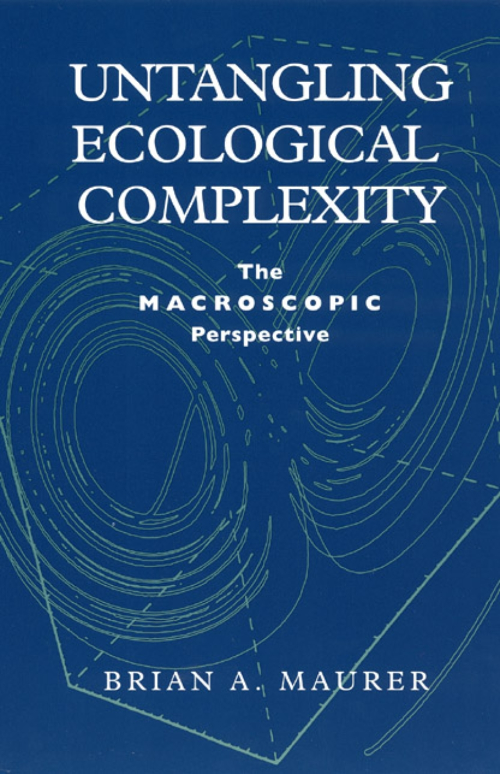

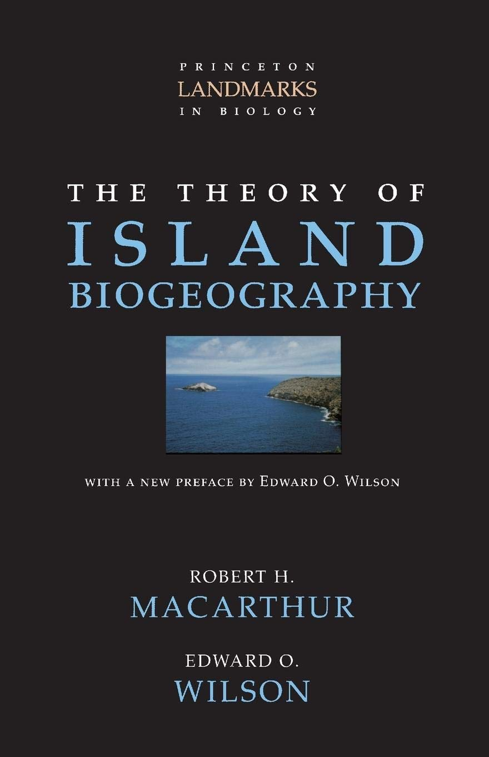



Slide 7
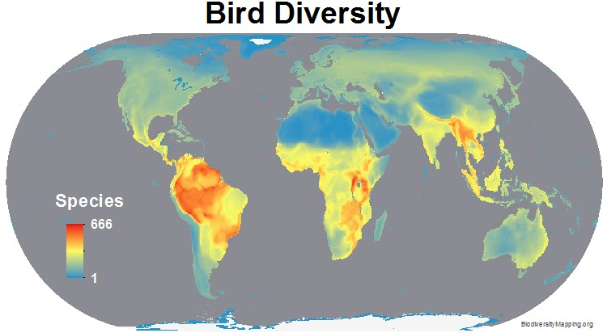
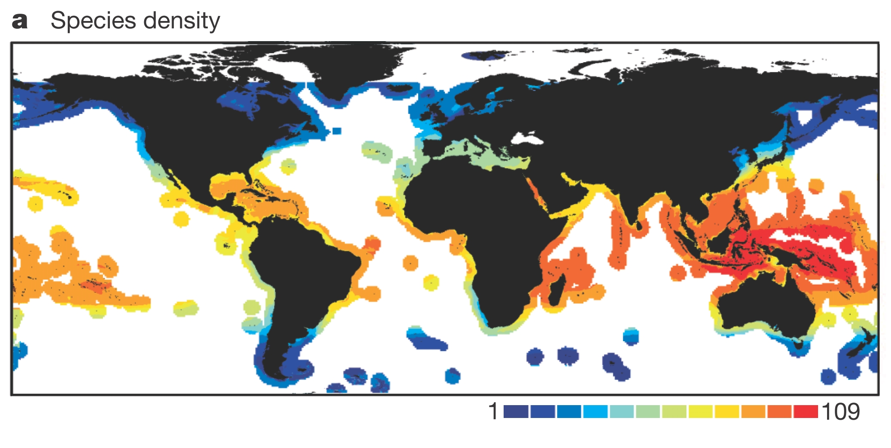
Bird Diversity
Vascular Plants
Marine Fishes
Global Diversity Patterns:
-Latitude
-Energy
-Evolution/Historic Biogeography
-Habitat Heterogeneity
-Human Influence
-….. And many more

Slide 8
Major Ecological Gradients
Latitude
Elevation
Energy/Productivity
Heterogeneity
Disturbance
Island size/Habitat Loss
Biogeography, other factors

Slide 9
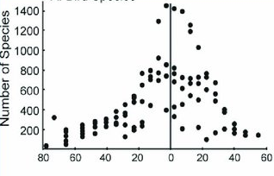
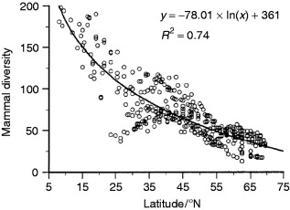
Latitude

Slide 10
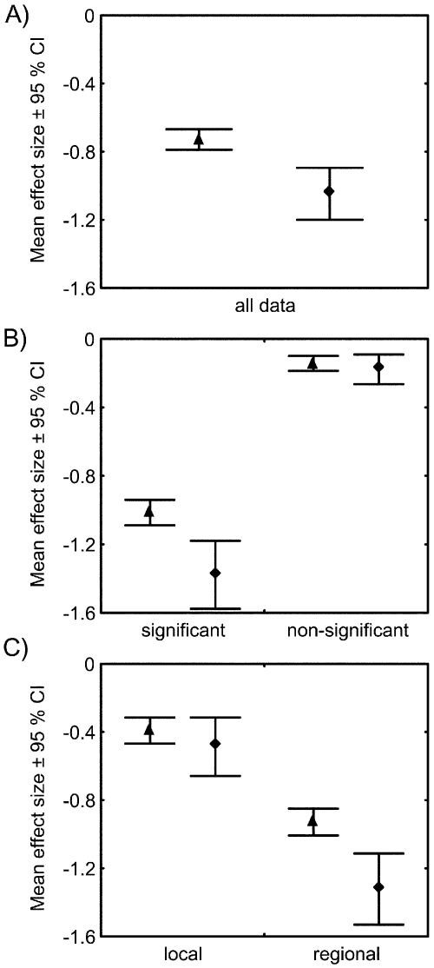
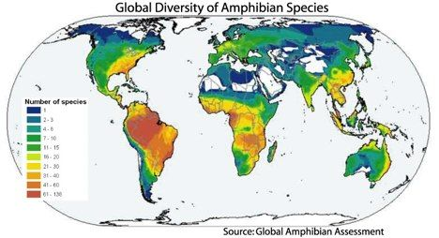
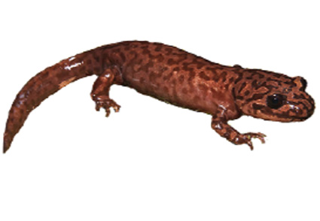
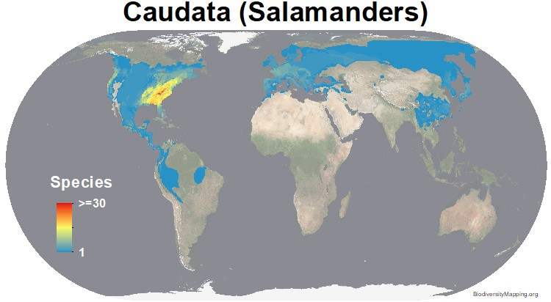
Hillebrand 2004, American Naturalist

Slide 11
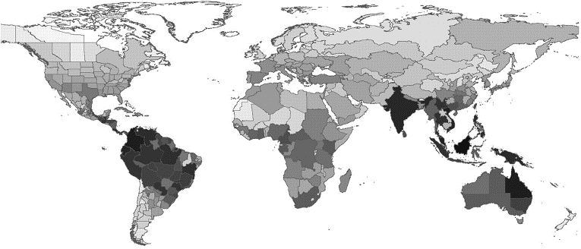
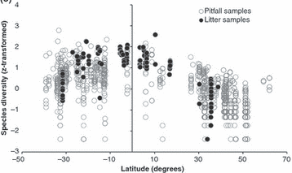
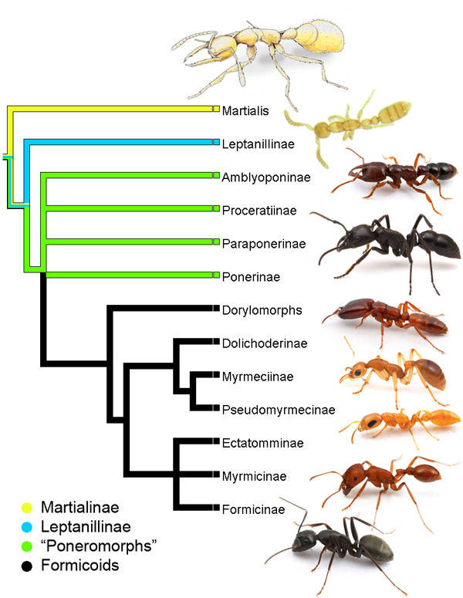
Biogeography matters
Dunn et al. 2009, Ecology Letters

Slide 12
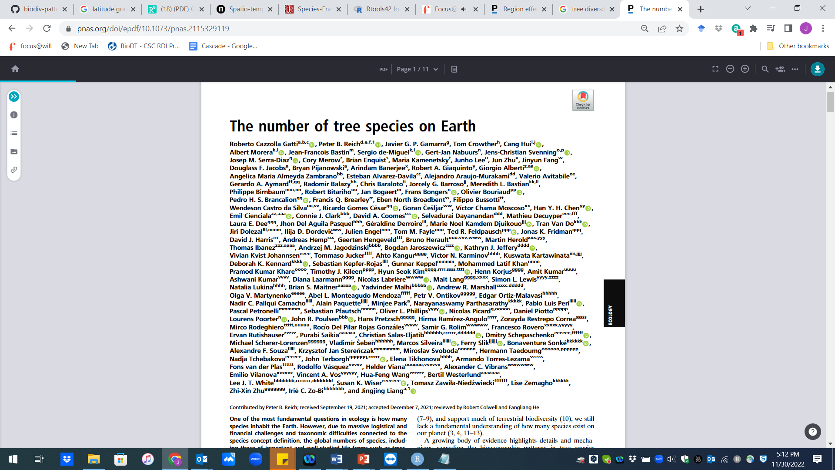
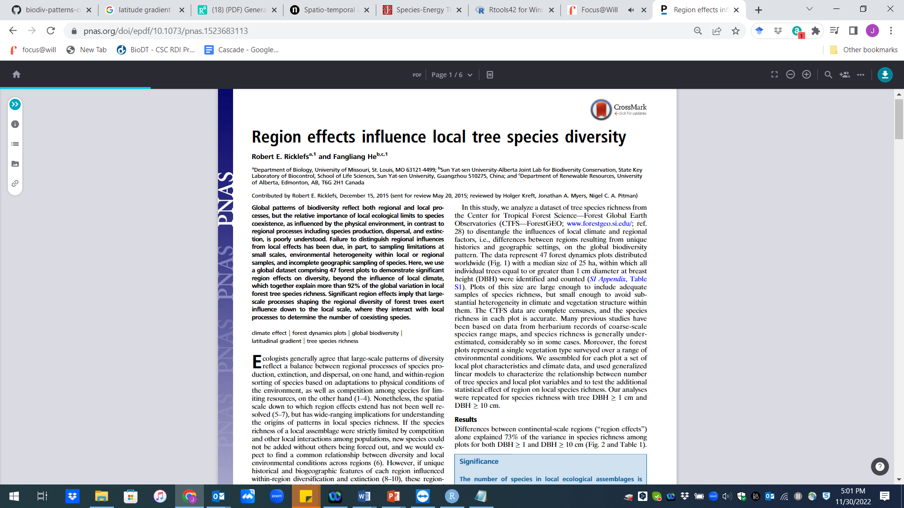
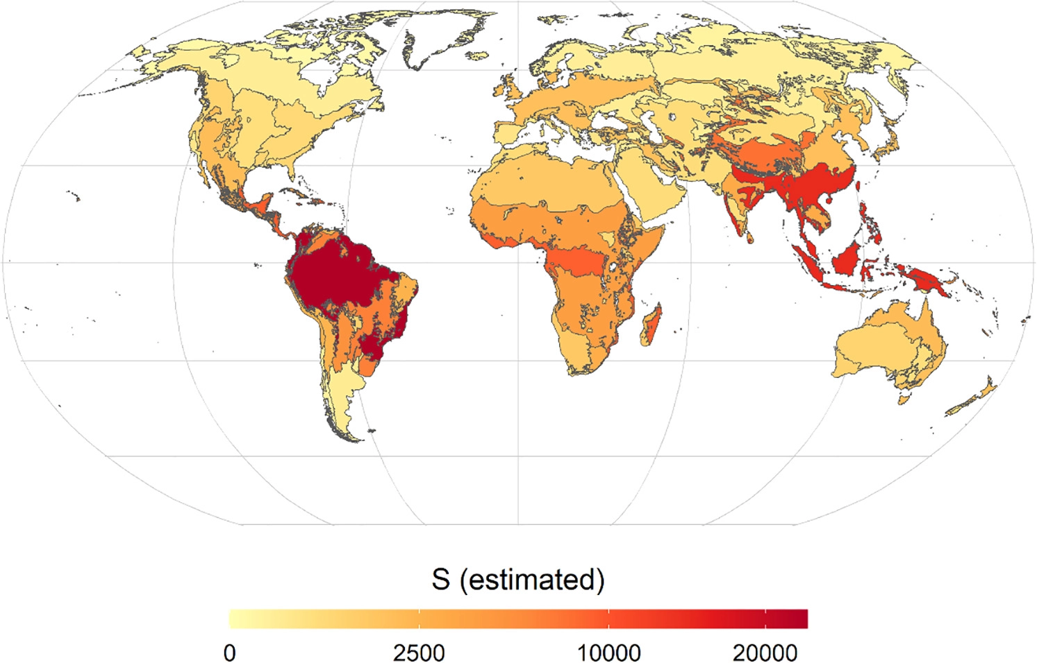
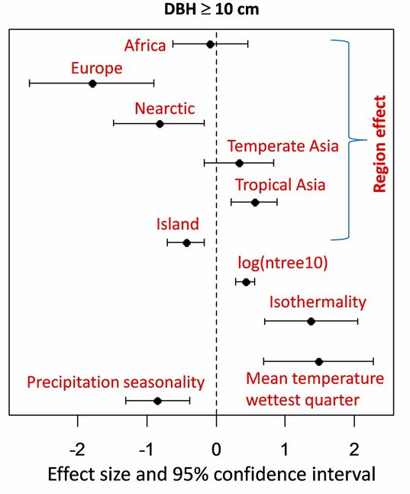

Slide 13
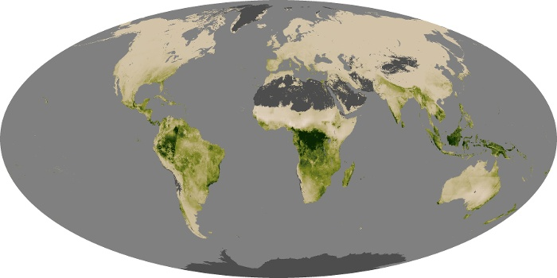
Why Latitude?
Area
Historical Biogeography
Climate
Global Net Productivity—NASA Observatory

Slide 14
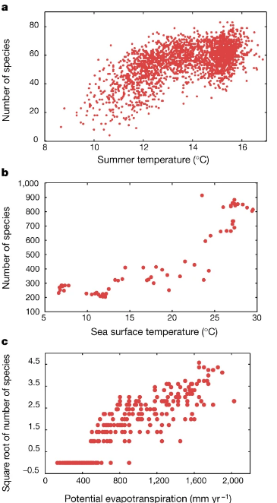
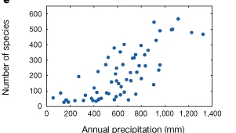
Precipitation, Energy, Temperature gradients

Slide 15
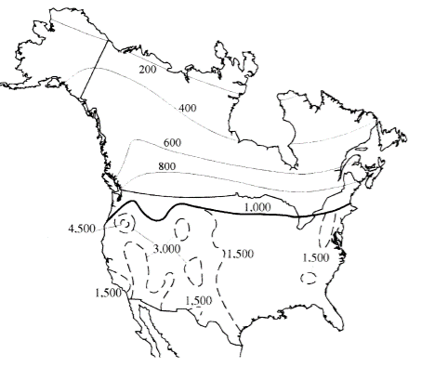
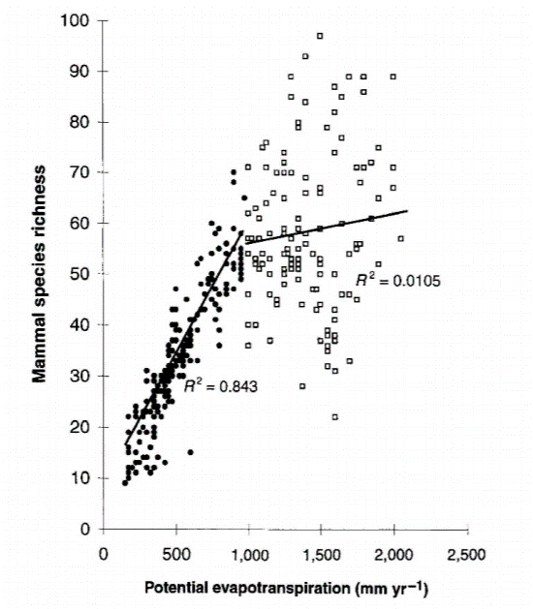
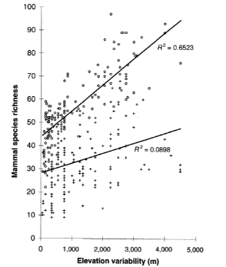
Habitat heterogeneity matters
Kerr and Packer 1997, Nature

